Slide 1
The God Who Delivers
Daniel 3:1-25

Slide 2
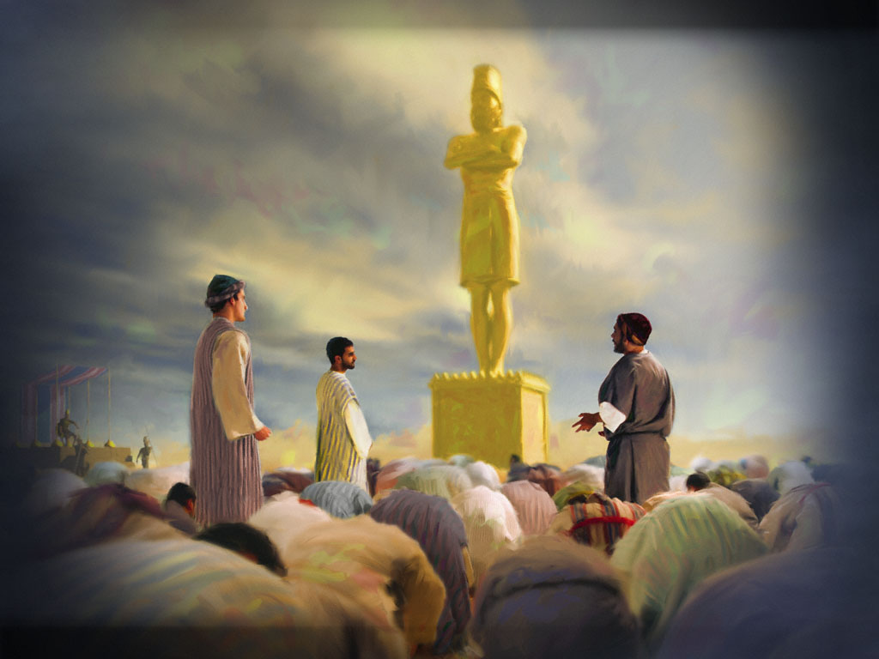

Slide 3
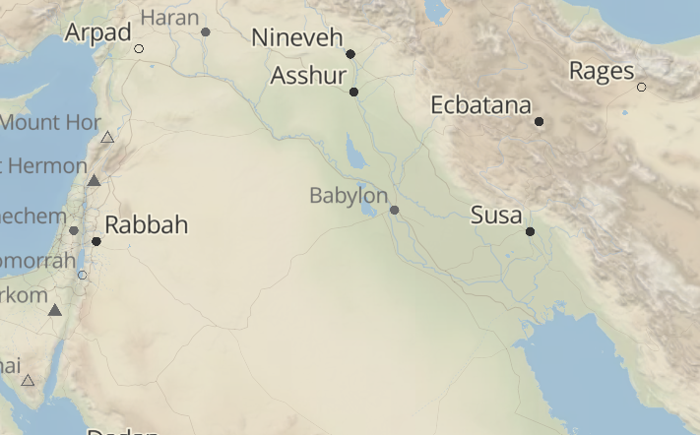

Slide 4
Daniel 3:15 (NKJV)
"15 Now if you are ready at the time you hear the sound of the horn, flute, harp, lyre, and psaltery, in symphony with all kinds of music, and you fall down and worship the image which I have made, good! But if you do not worship, you shall be cast immediately into the midst of a burning fiery furnace. And who is the god who will deliver you from my hands?”"

Slide 5
Daniel 3:16–18 (NKJV)
"16 Shadrach, Meshach, and Abed-Nego answered and said to the king, “O Nebuchadnezzar, we have no need to answer you in this matter. "17 If that is the case, our God whom we serve is able to deliver us from the burning fiery furnace, and He will deliver us from your hand, O king. "18 But if not, let it be known to you, O king, that we do not serve your gods, nor will we worship the gold image which you have set up.”"

Slide 6
Daniel 3:26 (NKJV)
"26 Then Nebuchadnezzar went near the mouth of the burning fiery furnace and spoke, saying, “Shadrach, Meshach, and Abed-Nego, servants of the Most High God, come out, and come here.” Then Shadrach, Meshach, and Abed-Nego came from the midst of the fire."

Slide 7
Daniel 3:28–29 (NKJV)
"28 …“Blessed be the God of Shadrach, Meshach, and Abed-Nego, who sent His Angel and delivered His servants who trusted in Him, and they have frustrated the king’s word, and yielded their bodies, that they should not serve nor worship any god except their own God! "29 Therefore I make a decree that any people, nation, or language which speaks anything amiss against the God of Shadrach, Meshach, and Abed-Nego shall be cut in pieces, and their houses shall be made an ash heap; because there is no other God who can deliver like this.”"

Slide 8
Digital Communications
Lesson #1: Let’s serve God without compromise.

Slide 9
Acts 4:12 (NKJV)
"12 Nor is there salvation in any other, for there is no other name under heaven given among men by which we must be saved.”"

Slide 10
Digital Communications
Lesson #1: Let’s serve God without compromise.
Lesson #2 God is the solution to would-be problems.

Slide 11
Digital Communications
Lesson #1: Let’s serve God without compromise.
Lesson #2 God is the solution to would-be problems.
Lesson #3: God is the God who delivers us.

Slide 12
Psalm 56:11 (NKJV)
"11 In God I have put my trust; I will not be afraid. What can man do to me?"

