Slide 1
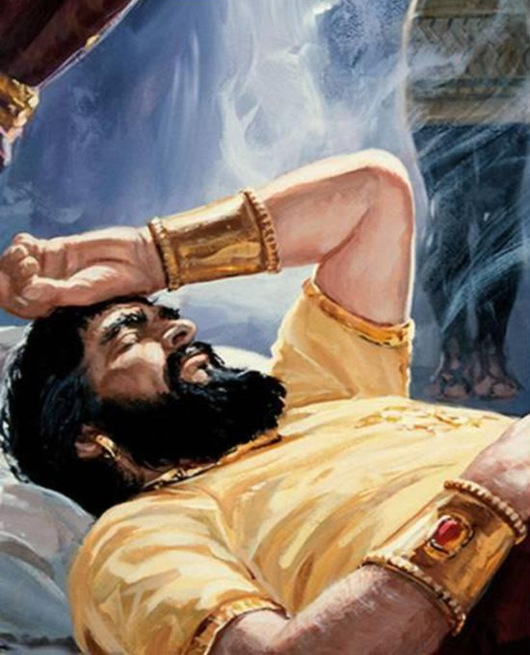
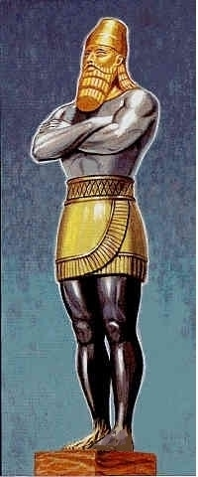
Daniel 2
The Certainty of God in an Uncertain World

Slide 2


Slide 3

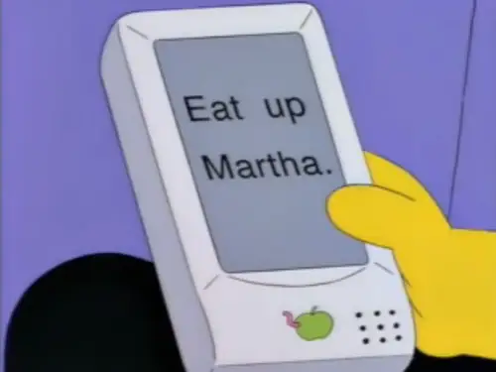

Slide 4
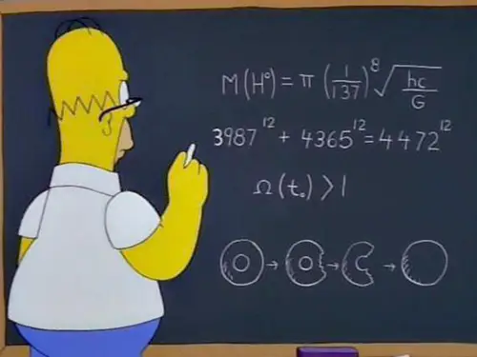

Slide 5
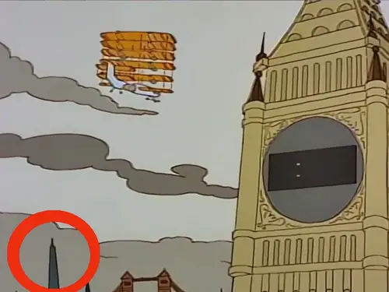

Slide 6


Slide 8
#1) The future is unknown to us. (Dan. 2:1-2, 10)
"3 And the king said to them, “I have had a dream, and my spirit is anxious to know the dream.”"
- Daniel 2:3 (NKJV)

Slide 9
#2) Though the future is unknown to us, the future is well known to God.
"17 Then Daniel went to his house, and made the decision known to Hananiah, Mishael, and Azariah, his companions, "18 that they might seek mercies from the God of heaven concerning this secret, so that Daniel and his companions might not perish with the rest of the wise men of Babylon. "19 Then the secret was revealed to Daniel in a night vision. So Daniel blessed the God of heaven."
- Daniel 2:17–19 (NKJV)

Slide 10
#2) Though the future is unknown to us, the future is well known to God.
"1 O Lord, You have searched me and known me. "2 You know my sitting down and my rising up; You understand my thought afar off. "3 You comprehend my path and my lying down, And are acquainted with all my ways. "4 For there is not a word on my tongue, But behold, O Lord, You know it altogether. "5 You have hedged me behind and before, And laid Your hand upon me. "6 Such knowledge is too wonderful for me; It is high, I cannot attain it."
- Psalm 139:1–6 (NKJV)

Slide 11
#3) The Future is made known to us.
"26 The king answered and said to Daniel, whose name was Belteshazzar, “Are you able to make known to me the dream which I have seen, and its interpretation?” "27 Daniel answered in the presence of the king, and said, “The secret which the king has demanded, the wise men, the astrologers, the magicians, and the soothsayers cannot declare to the king. "28 But there is a God in heaven who reveals secrets, and He has made known to King Nebuchadnezzar what will be in the latter days. Your dream, and the visions of your head upon your bed, were these: "29 As for you, O king, thoughts came to your mind while on your bed, about what would come to pass after this; and He who reveals secrets has made known to you what will be."
- Daniel 2:26–29 (NKJV)

Slide 12
#3) The Future is made known to us.
When God gives prophecy, God isn’t guessing about the future. It’s God revealing good news to a guessing world.”

Slide 13
#4) The Future Makes God known to us.
"45 Inasmuch as you saw that the stone was cut out of the mountain without hands, and that it broke in pieces the iron, the bronze, the clay, the silver, and the gold—the great God has made known to the king what will come to pass after this. The dream is certain, and its interpretation is sure.” "46 Then King Nebuchadnezzar fell on his face, prostrate before Daniel, and commanded that they should present an offering and incense to him. "47 The king answered Daniel, and said, “Truly your God is the God of gods, the Lord of kings, and a revealer of secrets, since you could reveal this secret.”"
- Daniel 2:45–47 (NKJV)

Slide 14
#4) The Future Makes God known to us.
"21 “Present your case,” says the Lord. “Bring forth your strong reasons,” says the King of Jacob. "22 “Let them bring forth and show us what will happen; Let them show the former things, what they were, That we may consider them, And know the latter end of them; Or declare to us things to come. "23 Show the things that are to come hereafter, That we may know that you are gods; Yes, do good or do evil, That we may be dismayed and see it together. "24 Indeed you are nothing, And your work is nothing; He who chooses you is an abomination."
- Isaiah 41:21–24 (NKJV)

Slide 15
#4) The Future Makes God known to us.
"29 “And now I have told you before it comes, that when it does come to pass, you may believe."
- John 14:29 (NKJV)

Slide 16
#4) The Future Makes God known to us.
“Never be afraid to trust and unknown future into the hands of God.”
– Corrie ten Boom

