Slide 2
Fear Not
Matthew 6:25-34; 8:23-27

Slide 3
Jesus Spoke About Fear
Jesus Tells Us Not to Worry (Mat. 6:25-34).
"25 “Therefore I say to you, do not worry about your life, what you will eat or what you will drink; nor about your body, what you will put on. Is not life more than food and the body more than clothing?

Slide 4
Jesus Spoke About Fear
Jesus Tells Us Not to Worry (Mat. 6:25-34).
"26 Look at the birds of the air, for they neither sow nor reap nor gather into barns; yet your heavenly Father feeds them. Are you not of more value than they? "27 Which of you by worrying can add one cubit to his stature? "28 “So why do you worry about clothing? Consider the lilies of the field, how they grow: they neither toil nor spin; "29 and yet I say to you that even Solomon in all his glory was not arrayed like one of these. "30 Now if God so clothes the grass of the field, which today is, and tomorrow is thrown into the oven, will He not much more clothe you, O you of little faith? "31 “Therefore do not worry, saying, ‘What shall we eat?’ or ‘What shall we drink?’ or ‘What shall we wear?’ "32 For after all these things the Gentiles seek. For your heavenly Father knows that you need all these things. "33 But seek first the kingdom of God and His righteousness, and all these things shall be added to you. "34 Therefore do not worry about tomorrow, for tomorrow will worry about its own things. Sufficient for the day is its own trouble." - Matthew 6:26–34 (NKJV)

Slide 5
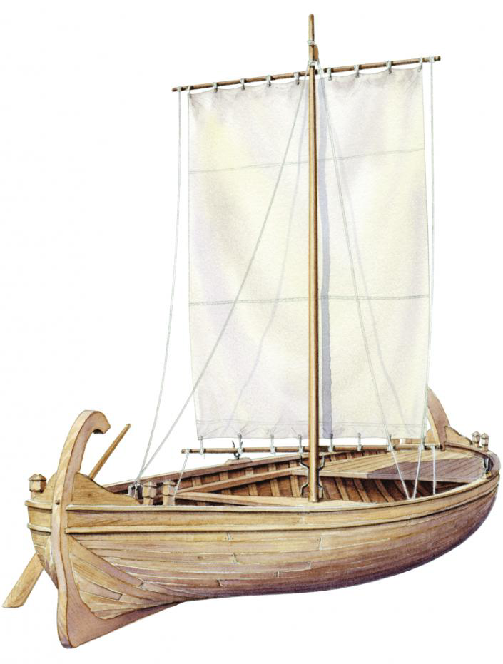
Jesus Spoke About Fear
Why are you afraid? (Mat. 8:23-27)
"23 Now when He got into a boat, His disciples followed Him. "24 And suddenly a great tempest arose on the sea, so that the boat was covered with the waves. But He was asleep. "25 Then His disciples came to Him and awoke Him, saying, “Lord, save us! We are perishing!” "26 But He said to them, “Why are you fearful, O you of little faith?” Then He arose and rebuked the winds and the sea, and there was a great calm. "27 So the men marveled, saying, “Who can this be, that even the winds and the sea obey Him?”" - Matthew 8:23–27 (NKJV)

Slide 6
Fear
"3 Whenever I am afraid, I will trust in You. "4 In God (I will praise His word), In God I have put my trust; I will not fear. What can flesh do to me?" - Psalm 56:3–4 (NKJV)

Slide 7
The Solution to Fear
Focus on size of God’s power, rather than the size of your problem.
Don’t fear failure. You are either winning or you are learning.
Look to God for guidance and instruction.
Trust in God, even when it doesn’t seem to make sense.
Surround yourselves with other people committed to the same goal.
Keep putting one step in front of the other.

