Slide 1
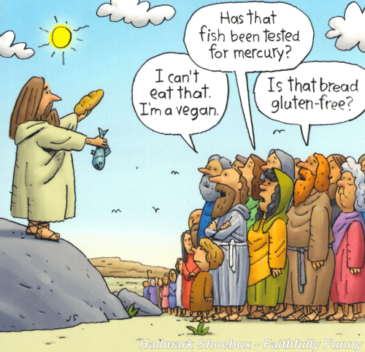
Complaining About Complaining
Numbers 11:1-20

Slide 2
Numbers 11:1–20 (NKJV)
"1 Now when the people complained, it displeased the Lord; for the Lord heard it, and His anger was aroused. So the fire of the Lord burned among them, and consumed some in the outskirts of the camp. "2 Then the people cried out to Moses, and when Moses prayed to the Lord, the fire was quenched. "3 So he called the name of the place Taberah, because the fire of the Lord had burned among them. "4 Now the mixed multitude who were among them yielded to intense craving;..

Slide 3
Numbers 11:1–20 (NKJV)
…so the children of Israel also wept again and said: “Who will give us meat to eat? "5 We remember the fish which we ate freely in Egypt, the cucumbers, the melons, the leeks, the onions, and the garlic; "6 but now our whole being is dried up; there is nothing at all except this manna before our eyes!” "7 Now the manna was like coriander seed, and its color like the color of bdellium. "8 The people went about and gathered it, ground it on millstones or beat it in the mortar, cooked it in…

Slide 4
Numbers 11:1–20 (NKJV)
… pans, and made cakes of it; and its taste was like the taste of pastry prepared with oil. "9 And when the dew fell on the camp in the night, the manna fell on it. "10 Then Moses heard the people weeping throughout their families, everyone at the door of his tent; and the anger of the Lord was greatly aroused; Moses also was displeased. "11 So Moses said to the Lord, “Why have You afflicted Your servant? And why have I not found favor in Your sight, that You have laid the burden of all these people on me? "12 Did I conceive all these people? Did I beget them,...

Slide 5
Numbers 11:1–20 (NKJV)
..that You should say to me, ‘Carry them in your bosom, as a guardian carries a nursing child,’ to the land which You swore to their fathers? "13 Where am I to get meat to give to all these people? For they weep all over me, saying, ‘Give us meat, that we may eat.’ "14 I am not able to bear all these people alone, because the burden is too heavy for me. "15 If You treat me like this, please kill me here and now—if I have found favor in Your sight—and do not let me see my wretchedness!” "16 So the Lord said to Moses: “Gather to Me seventy men of the elders of Israel, whom you know to be the elders of the people and officers over them; bring them to the tabernacle of meeting, that they may stand there with you…

Slide 6
Numbers 11:1–20 (NKJV)
"17 Then I will come down and talk with you there. I will take of the Spirit that is upon you and will put the same upon them; and they shall bear the burden of the people with you, that you may not bear it yourself alone. "18 Then you shall say to the people, ‘Consecrate yourselves for tomorrow, and you shall eat meat; for you have wept in the hearing of the Lord, saying, “Who will give us meat to eat? For it was well with us in Egypt.” Therefore the Lord will give you meat, and you shall eat. "19 You shall eat, not one day, nor two days, nor five days, nor ten days, nor twenty days, "20 but for a whole month, until it comes out of your nostrils and becomes loathsome to you, because you have despised the Lord who is among you, and have wept before Him, saying, “Why did we ever come up out of Egypt?” ’ ”"

Slide 7
Numbers 11:1–20 (NKJV)
What do your complaints say to God? (God is listening!)
“The Lord heard it.” (11:1)

Slide 8
Numbers 11:1–20 (NKJV)
Don’t complain to people who can’t do anything about the problem. Pray about it instead.
“Who will give us meat to eat?” (11:4)

Slide 9
Numbers 11:1–20 (NKJV)
Some complaining is Warranted
“Who will give us meat to eat?” (11:4)

Slide 10
Numbers 11:1–20 (NKJV)
It’s not fair to revise history to make your complaint sound more valid.
“We remember the fish which we ate freely in Egypt, the cucumbers, the melons, the leeks, the onions, and the garlic…” (11:5)

Slide 11
Numbers 11:1–20 (NKJV)
You shouldn’t complain if you were party to the decision.
“Why did we ever come up out of Egypt?” (11:20)

Slide 12
Numbers 11:1–20 (NKJV)
What do your complaints do to others/the Church?
“So, Moses said to the LORD, “Why have You afflicted Your servant? And why have I not found favor in Your sight, that You have laid the burden of all these people on me? 12 Did I conceive all these people? Did I beget them, that You should say to me, ‘Carry them in your bosom, as a guardian carries a nursing child,’ to the land which You swore to their fathers? 13 Where am I to get meat to give to all these people? For they weep all over me, saying, ‘Give us meat, that we may eat.’ 14 I am not able to bear all these people alone, because the burden is too heavy for me. 15 If You treat me like this, please kill me here and now—if I have found favor in Your sight—and do not let me see my wretchedness!” (11:11-15)

Slide 13
Numbers 11:1–20 (NKJV)
Complaining Often Encourages More Complaining
“So, Moses said to the LORD, “Why have You afflicted Your servant? And why have I not found favor in Your sight, that You have laid the burden of all these people on me? 12 Did I conceive all these people? Did I beget them, that You should say to me, ‘Carry them in your bosom, as a guardian carries a nursing child,’ to the land which You swore to their fathers? 13 Where am I to get meat to give to all these people? For they weep all over me, saying, ‘Give us meat, that we may eat.’ 14 I am not able to bear all these people alone, because the burden is too heavy for me. 15 If You treat me like this, please kill me here and now—if I have found favor in Your sight—and do not let me see my wretchedness!” (11:11-15)

Slide 14
Numbers 11:1–20 (NKJV)
Instead of complaining, use your energy to create a solution to the problem.
“Gather to Me seventy men of the elders of Israel, whom you know to be the elders of the people and officers over them; bring them to the tabernacle of meeting, that they may stand there with you. "17 Then I will come down and talk with you there. I will take of the Spirit that is upon you and will put the same upon them; and they shall bear the burden of the people with you, that you may not bear it yourself alone. (11:16-18)
"14 Do all things without complaining and disputing," - Philippians 2:14 (NKJV)

Slide 15
Numbers 11:1–20 (NKJV)
Is it even a valid complaint?

